Slide 1
Software Engineering Unit-V
Prepared By: Neha Tripathi

Slide 2
Software Quality

Slide 3
Software Quality
Traditionally, a quality product is defined in terms of its fitness of purpose. That is, a quality product does exactly what the users want it to do.
For software products, fitness of purpose is usually interpreted in terms of satisfaction of the requirements laid down in the SRS document.
The traditional concept of quality as “fitness of purpose” for software products is not wholly satisfactory. The modern view of a quality associates with a software product several quality factors such as the following:
- Portability
- Usability
- Reusability
- Correctness
- Maintainability

Slide 4
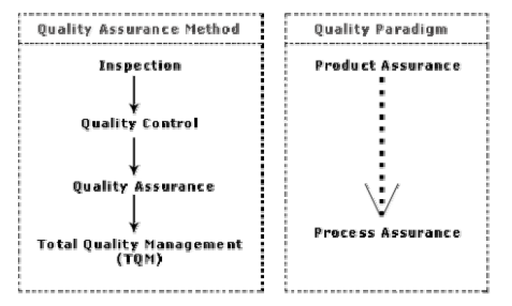
Evolution of quality system and corresponding shift in the quality paradigm

Slide 5
ISO 9000
ISO 9000 certification
ISO (International Standards Organization) is a consortium of 63 countries established to formulate and foster standardization.
ISO published its 9000 series of standards in 1987.
ISO certification serves as a reference for contract between independent parties.
The ISO 9000 standard specifies the guidelines for maintaining a quality system.
The ISO standard mainly addresses operational aspects and organizational aspects such as responsibilities, reporting, etc.
In a nutshell, ISO 9000 specifies a set of guidelines for repeatable and high quality product development.
It is important to realize that ISO 9000 standard is a set of guidelines for the production process and is not directly concerned about the product itself.

Slide 6
Types of ISO 9000 quality standards
ISO 9001 applies to the organizations engaged in design, development, production, and servicing of goods. This is the standard that is applicable to most software development organizations.
ISO 9002 applies to those organizations which do not design products but are only involved in production. Examples of these category industries include steel and car manufacturing industries that buy the product and plant designs from external sources and are involved in only manufacturing those products. Therefore, ISO 9002 is not applicable to software development organizations.
ISO 9003 applies to organizations that are involved only in installation and testing of the products.

Slide 7
Need for obtaining ISO 9000 certification
• Confidence of customers in an organization increases when organization qualifies for ISO certification.
• ISO 9000 requires a well-documented software production process to be in place. A well-documented software production process contributes to repeatable and higher quality of the developed software.
• ISO 9000 makes the development process focused, efficient, and cost effective.
• ISO 9000 certification points out the weak points of an organization
and recommends remedial action.
• ISO 9000 sets the basic framework for the development of an optimal process and Total Quality Management (TQM).

Slide 8
Shortcomings of ISO 9000 certification
ISO 9000 requires a software production process to be adhered to but does not guarantee the process to be of high quality. It also does not give any guideline for defining an appropriate process.
• ISO 9000 certification process is not fool-proof and no international accreditation agency exists. Therefore it is likely that variations in the norms of awarding certificates can exist among the different accreditation agencies and also among the registrars.
• Organizations getting ISO 9000 certification often tend to downplay domain expertise.
• ISO 9000 does not automatically lead to continuous process improvement, i.e. does not automatically lead to TQM.

Slide 9
SEI Capability Maturity Model
SEI Capability Maturity Model (SEI CMM) helped organizations to improve the quality of the software they develop and therefore adoption of SEI CMM model has significant business benefits.
SEI CMM can be used two ways:
- capability evaluation and
- software process assessment
Capability evaluation provides a way to assess the software process capability of an organization.
Software process assessment is used by an organization with the objective to improve its process capability.

Slide 10
SEI CMM-Maturity levels
SEI CMM classifies software development industries into the following five maturity levels:
- Initial
- Repeatable
- Defined
- Managed
- Optimized
SEI CMM provides a list of key areas on which to focus to take an organization from one level of maturity to the next. Thus, it provides a way for gradual quality improvement over several stages.
Each stage has been carefully designed such that one stage enhances the capability already built up.

Slide 11
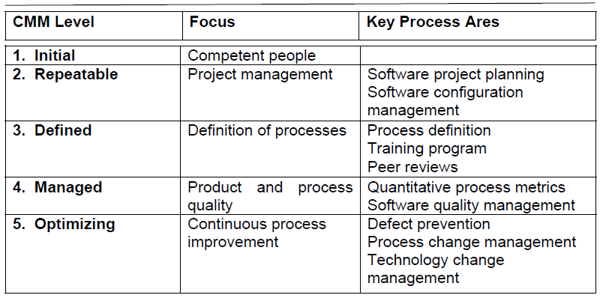
The focus of each SEI CMM level and the corresponding key process area (KPAs)

Slide 12
ISO 9000 certification vs. SEI/CMM
• ISO 9000 is awarded by an international standards body. Therefore, ISO 9000 certification can be quoted by an organization in official documents, communication with external parties, and the tender quotations. However, SEI CMM assessment is purely for internal use.
• SEI CMM was developed specifically for software industry and therefore addresses many issues which are specific to software industry alone.
• SEI CMM goes beyond quality assurance and prepares an organization to ultimately achieve Total Quality Management (TQM). In fact, ISO 9001 aims at level 3 of SEI CMM model.
• SEI CMM model provides a list of key process areas (KPAs) on which an organization at any maturity level needs to concentrate to take it from one maturity level to the next. Thus, it provides a way for achieving gradual quality improvement.

Slide 13
Thank you!

